Slide 1
To Mob*, Pair, or Fly Solo
ACCU Cambridge 2025
*Ensemble
Chris Oldwood
Notes:
Who am I? What’s my background in ensemble programming?
Sceptic – programming not about what I thought it was.

Slide 2
Productivity
The elephant in the room

Slide 3
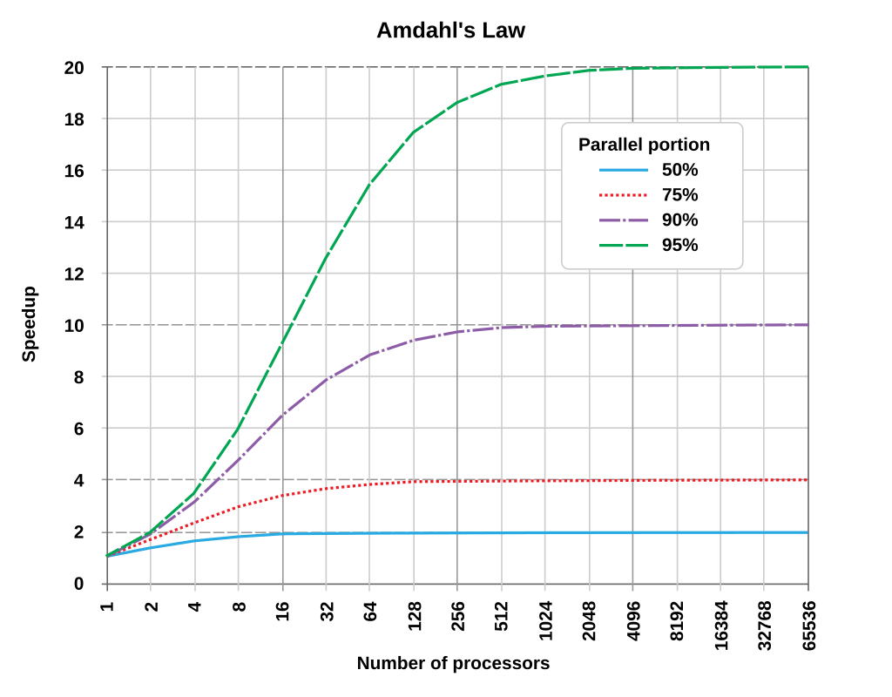
Amdahl's Law

Slide 4
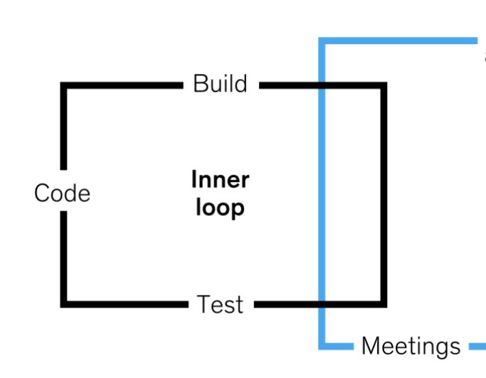
“The McKinsey Loop”

Slide 5

Gilb’s Law
“Anything you need to quantify can be measured in some way that is superior to not measuring it at all.”
-- Tom Gilb, Peopleware

Slide 6
Poor Measurements
Lines of code / functions
Commits / pull requests
Bugs fixed / tickets closed
Hours worked

Slide 7
Goodhart's Law
“When a measure becomes a target, it ceases to be a good measure.”

Slide 8
Agile Manifesto
“Working software is the primary measure of progress”

Slide 9
DORA Metrics
Mean lead time for changes
Deployment frequency
Change failure rate
Mean time to recover

Slide 10
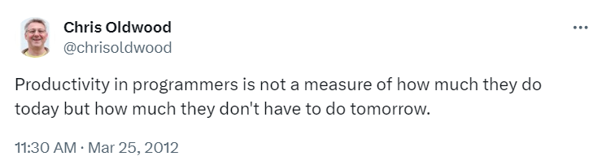
The Long Game

Slide 11

Gall’s Law
“A complex system that works is invariably found to have evolved from a simple system that worked.”
-- John Gall, Systemantics (aka The Systems Bible)

Slide 12

Flow vs Efficiency

Slide 13
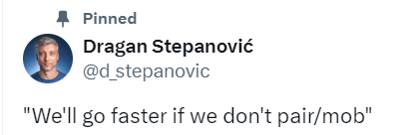
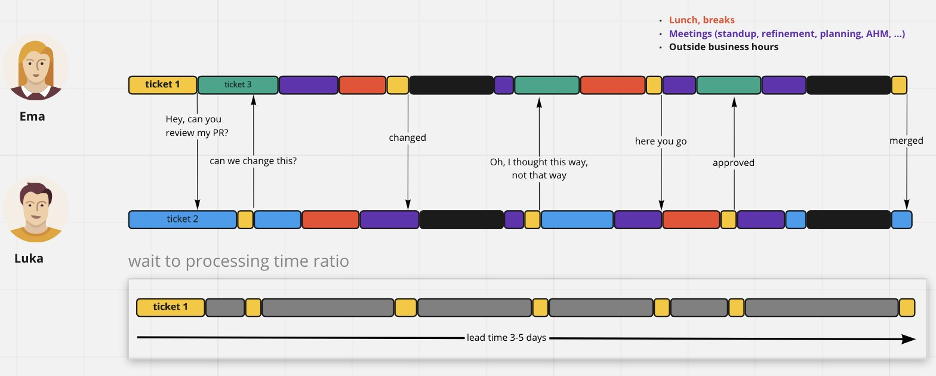
https://x.com/d_stepanovic/status/1379451260638785536

Slide 14
Collaboration
Sharing knowledge and a vision

Slide 15

Egoless Programming
“…If asked, most programmers would probably say they preferred to work alone in a place where they wouldn’t be disturbed by other people…
The ideas expressed in the preceding paragraph are possibly the most formidable barrier to improved programming that we shall encounter.”
-- Gerry Weinberg, The Psychology of Computer Programming, 1971.

Slide 16
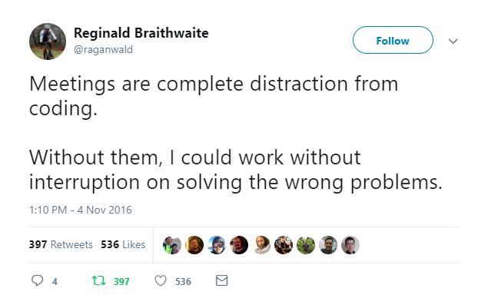
Meetings are Collaboration

Slide 17
Collaboration Aphorisms
“Two heads are better than one”
“Many hands make light work”
“The wisdom of crowds”
“A rising tide lifts all boats”
“A problem shared is a problem halved”

Slide 18
Newton’s Third Law?
“Too many cooks spoil the broth”
“Jack of all trades, master of none…”

Slide 19
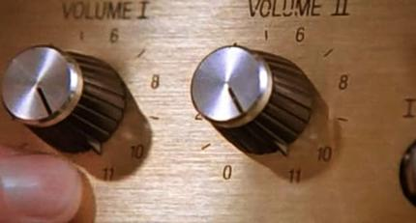
Turning Up The Dial
https://en.wikipedia.org/wiki/File:Spinal_Tap_-_Up_to_Eleven.jpg

Slide 20
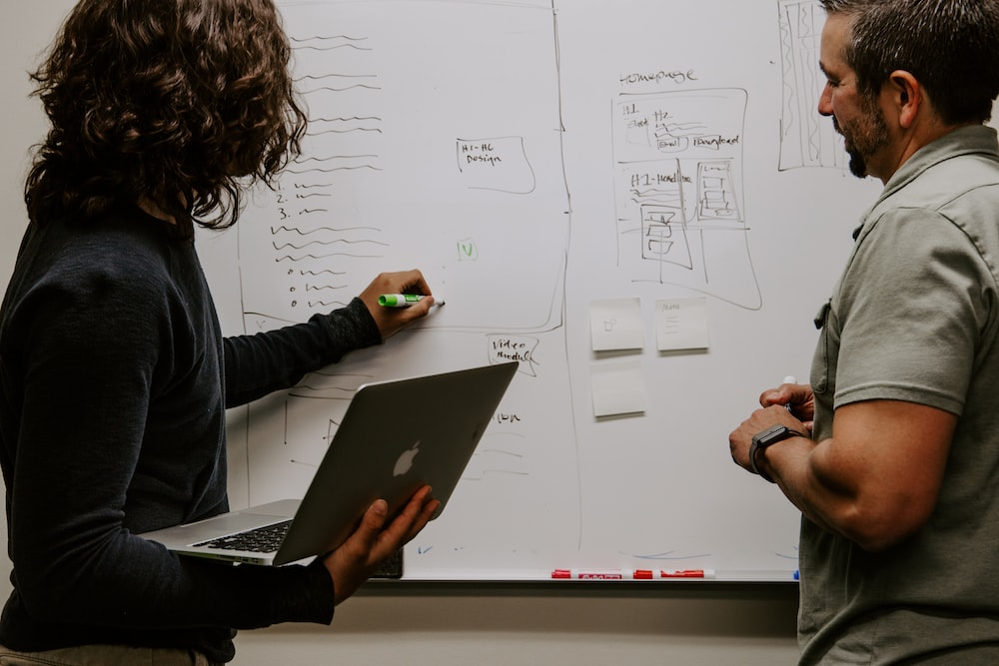
Shared Understanding
https://unsplash.com/photos/3V8xo5Gbusk

Slide 21
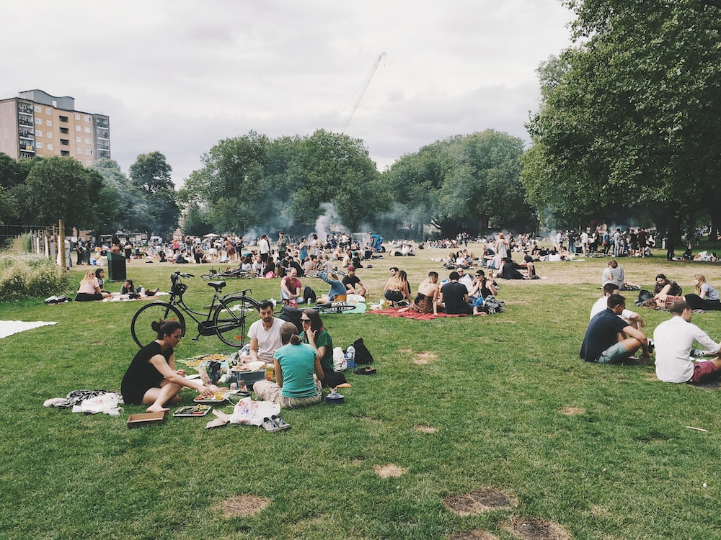
Shared Ownership
https://unsplash.com/photos/4hcpIbqQM8c

Slide 22

Continuous Improvement
https://unsplash.com/photos/kcT-7cirBEw

Slide 23
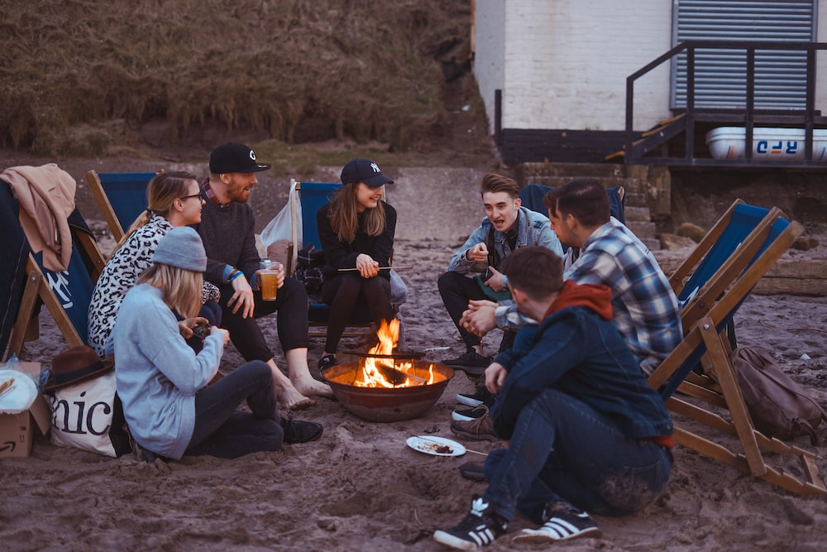
It’s Fun!
https://unsplash.com/photos/x9I-6yoXrXE

Slide 24
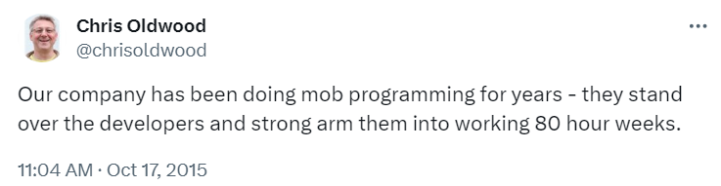
A Note on Terminology

Slide 25
Ensemble Programming
Focusing the team

Slide 26
Pair Programming
Programming in small teams

Slide 27
Flying Solo
Administration & education

Slide 28

Ebbs & Flows
https://unsplash.com/photos/body-of-water-under-sky-6ArTTluciuA

Slide 29
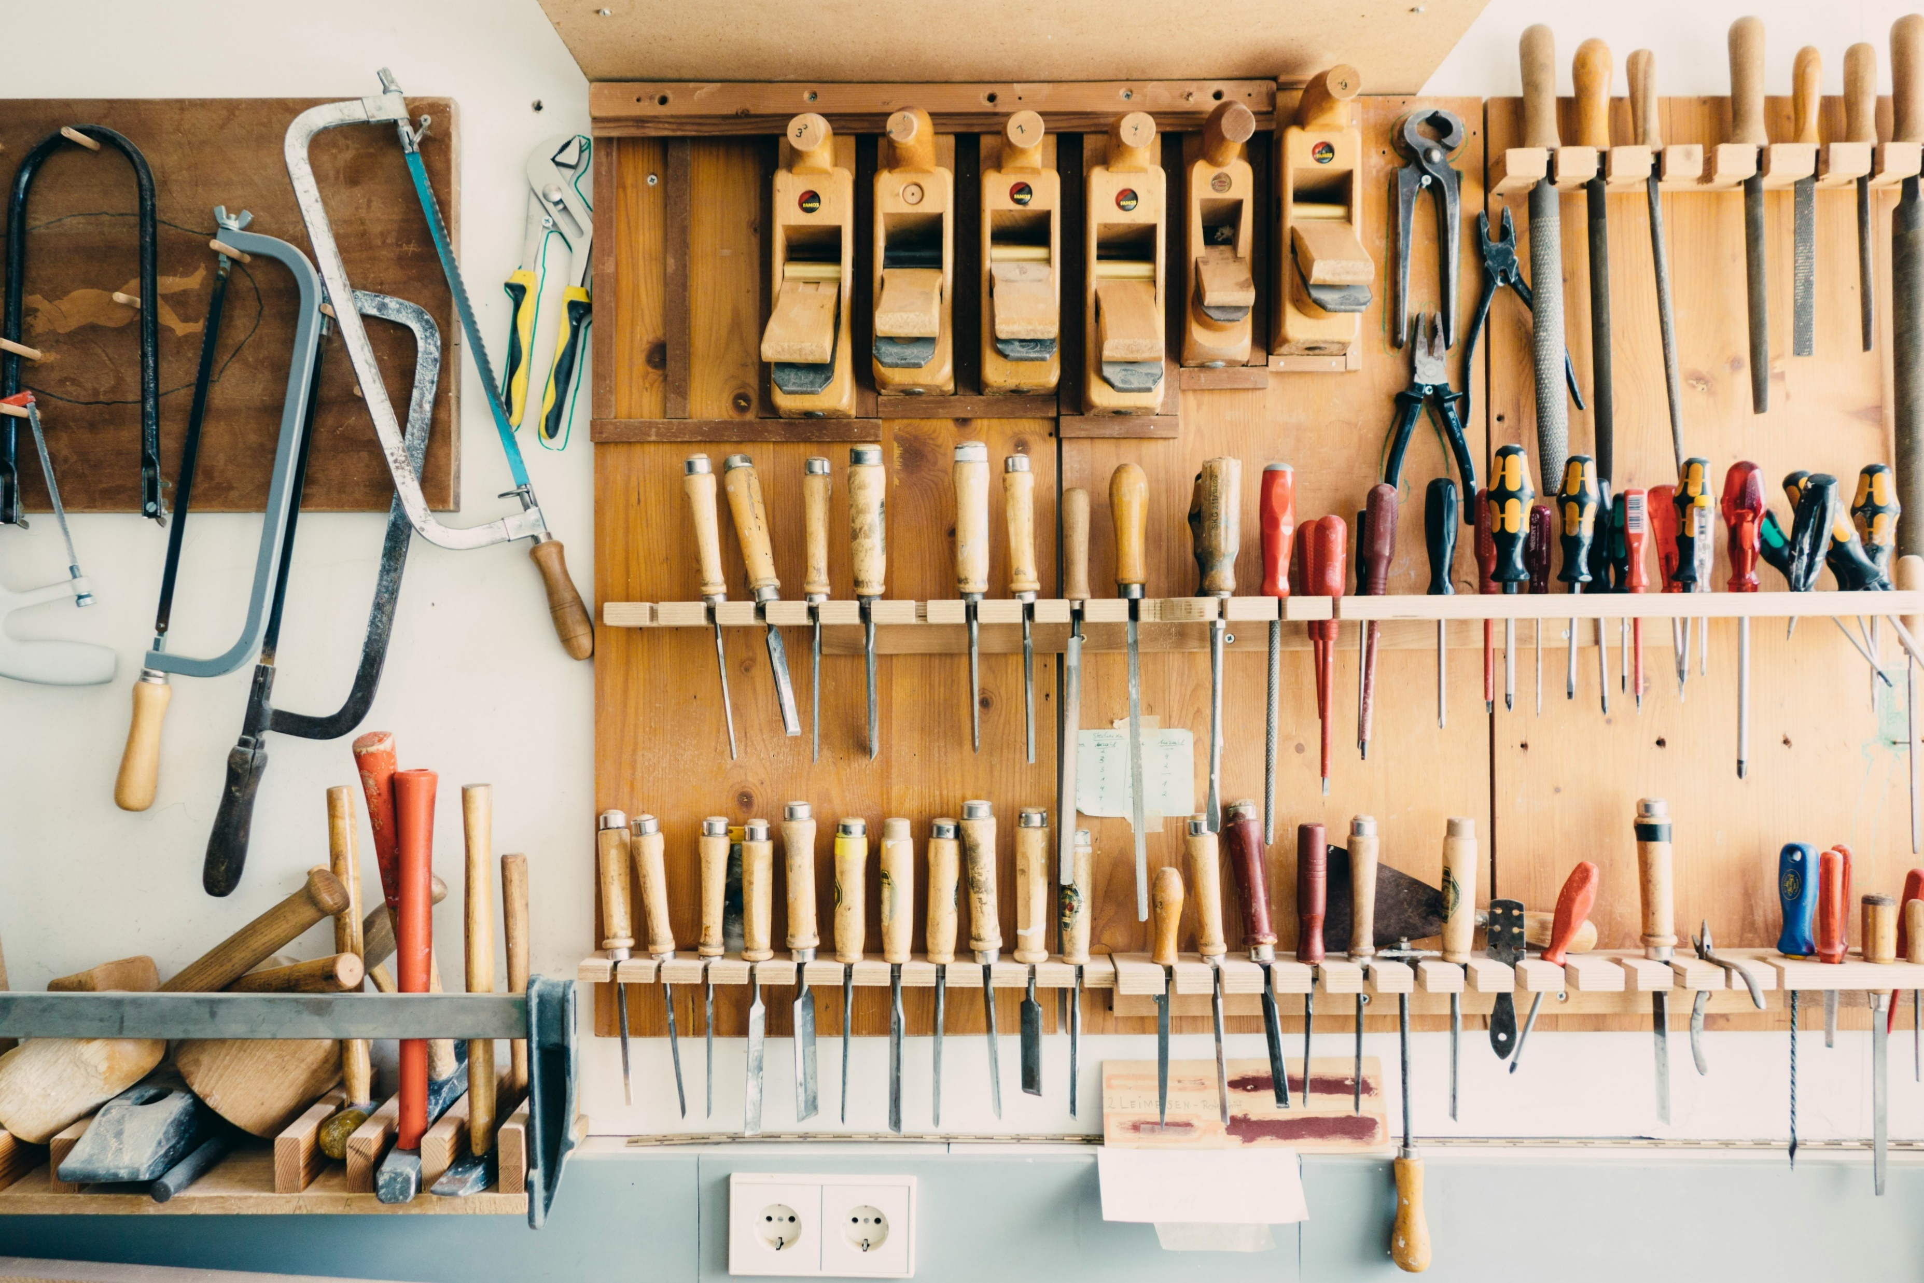
Tooling
https://unsplash.com/photos/assorted-handheld-tools-in-tool-rack-t5YUoHW6zRo

Slide 30

Literature

Slide 31
Clocking Off
Blog:
http://chrisoldwood.blogspot.co.uk
Articles:
http://chrisoldwood.com/articles.htm
C Vu 30-5: To Mob, Pair, or Fly Solo:
http://www.chrisoldwood.com/articles/to-mob-pair-or-fly-solo.html

