Slide 1
The Test-Driven Developer
Norfolk Developers Conference 2026
Chris Oldwood
Notes:
Was going to be called Test-Driven Development, then just Test-Driven, the “focus group” liked this variant.
Not about TDD per-se, more about the wider aspects of test-first thinking.

Slide 2
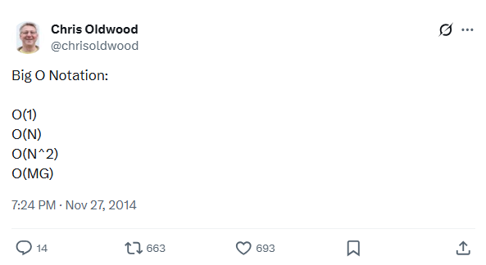
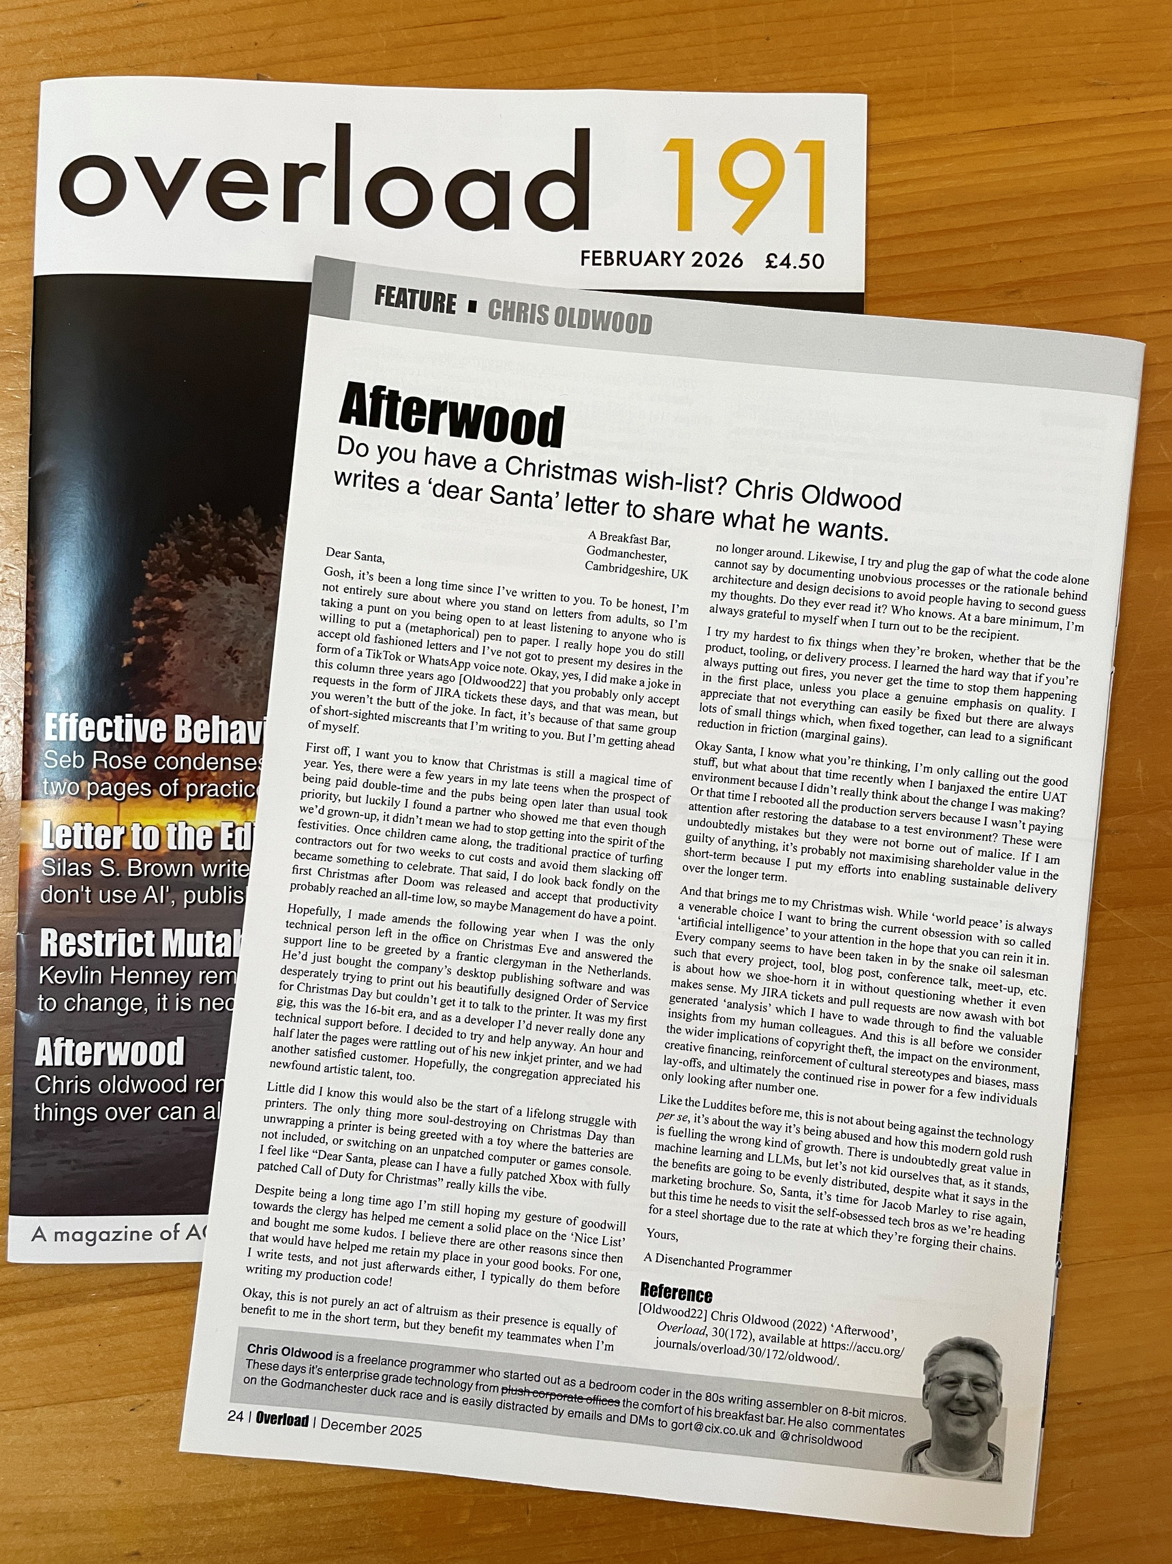
Who Am I?
https://x.com/chrisoldwood/status/538050740045250560
https://accu.org/menu-overviews/journals-overview
Notes:
Nobody’s really interested in the speaker’s background, but sometimes they like to know their “credentials”.
Been a dev for over 30 years and have spoken at NorDevCon before a few times (2025: Ensemble programming, 2019: Test of Strength, 2013: Test Driven SQL).
Once tweeted something funny, never replicated that success despite over a decade of trying.
I write a column in (probably) the last remaining printed programming journal.

Slide 3
A Journey
My path to enlightenment

Slide 4
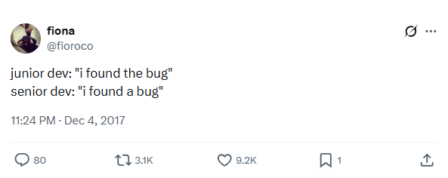
One Night in the Pub…
Notes:
Genesis: a conversation in the pub after a meet-up.
Me ranting about a not-inexperienced member of the team pushing a PR with code that doesn’t even parse, let alone do the right thing.

Slide 5
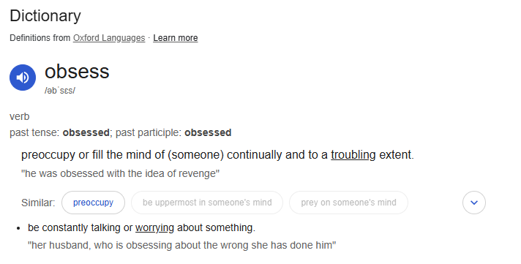
Test Obsessed?

Slide 6
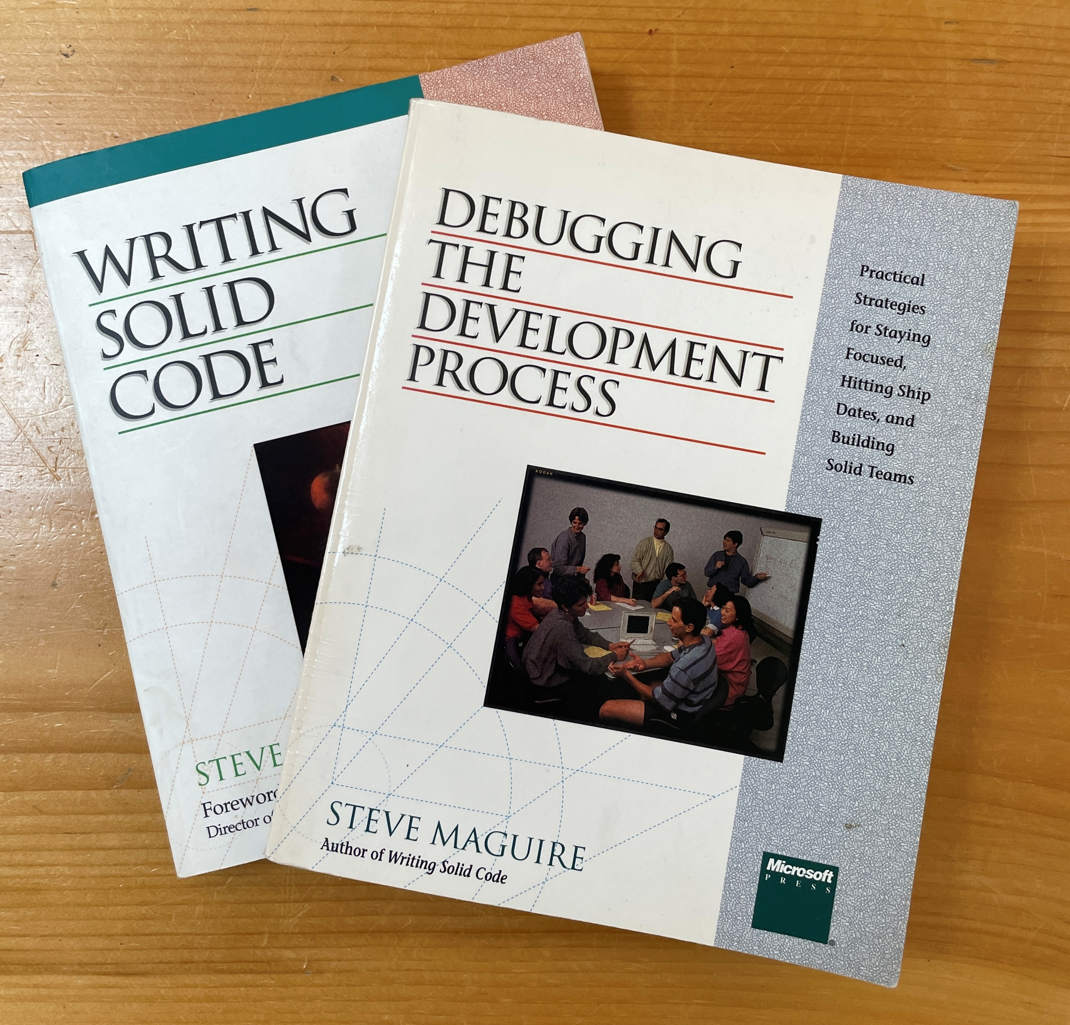
Test Thinking
1. How could I have prevented this bug?
2. How could I have (automatically) detected this bug?
Never allow the same bug to bite you twice
Notes:
The two questions every developer should ask

Slide 7
Test Doing
“Step Through Your Code”
…which lead to…
more easily testable code

Slide 8
Test-First Thinking
“Before making a change, first ask yourself: How do I test this?”

Slide 9
Practices
Examples of a test-driven mindset

Slide 10
Where to Begin?

Slide 11
The Customer!
What does success look like?
Acceptance Criteria
Conditions of Satisfaction
These are tests by another name

Slide 12
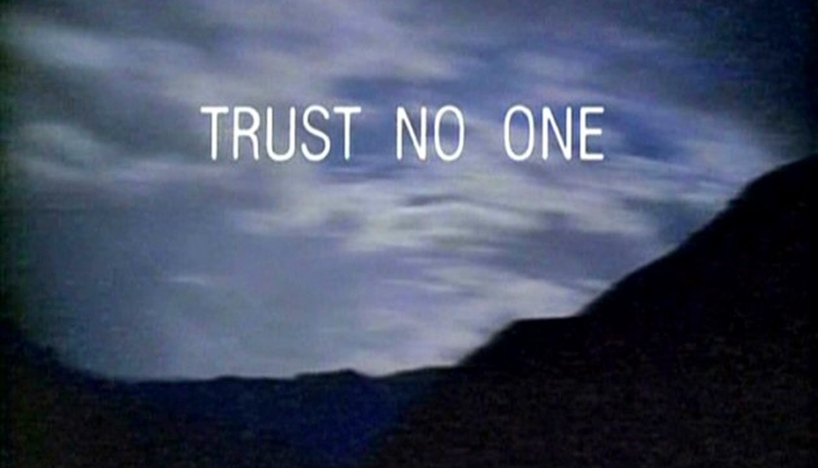
Test Plans
https://en.wikipedia.org/wiki/The_X-Files

Slide 13
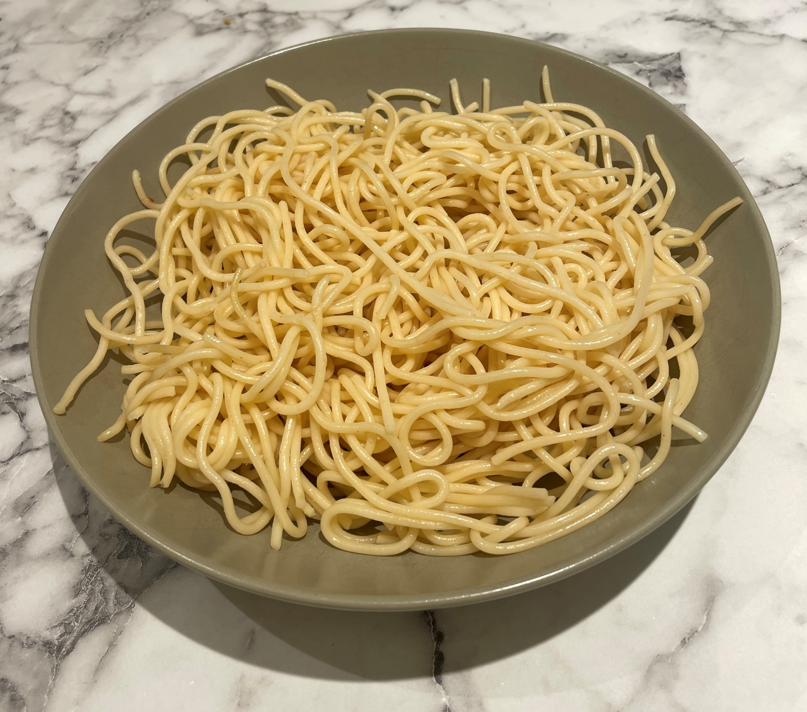
What If I Can’t Easily Test This?

Slide 14
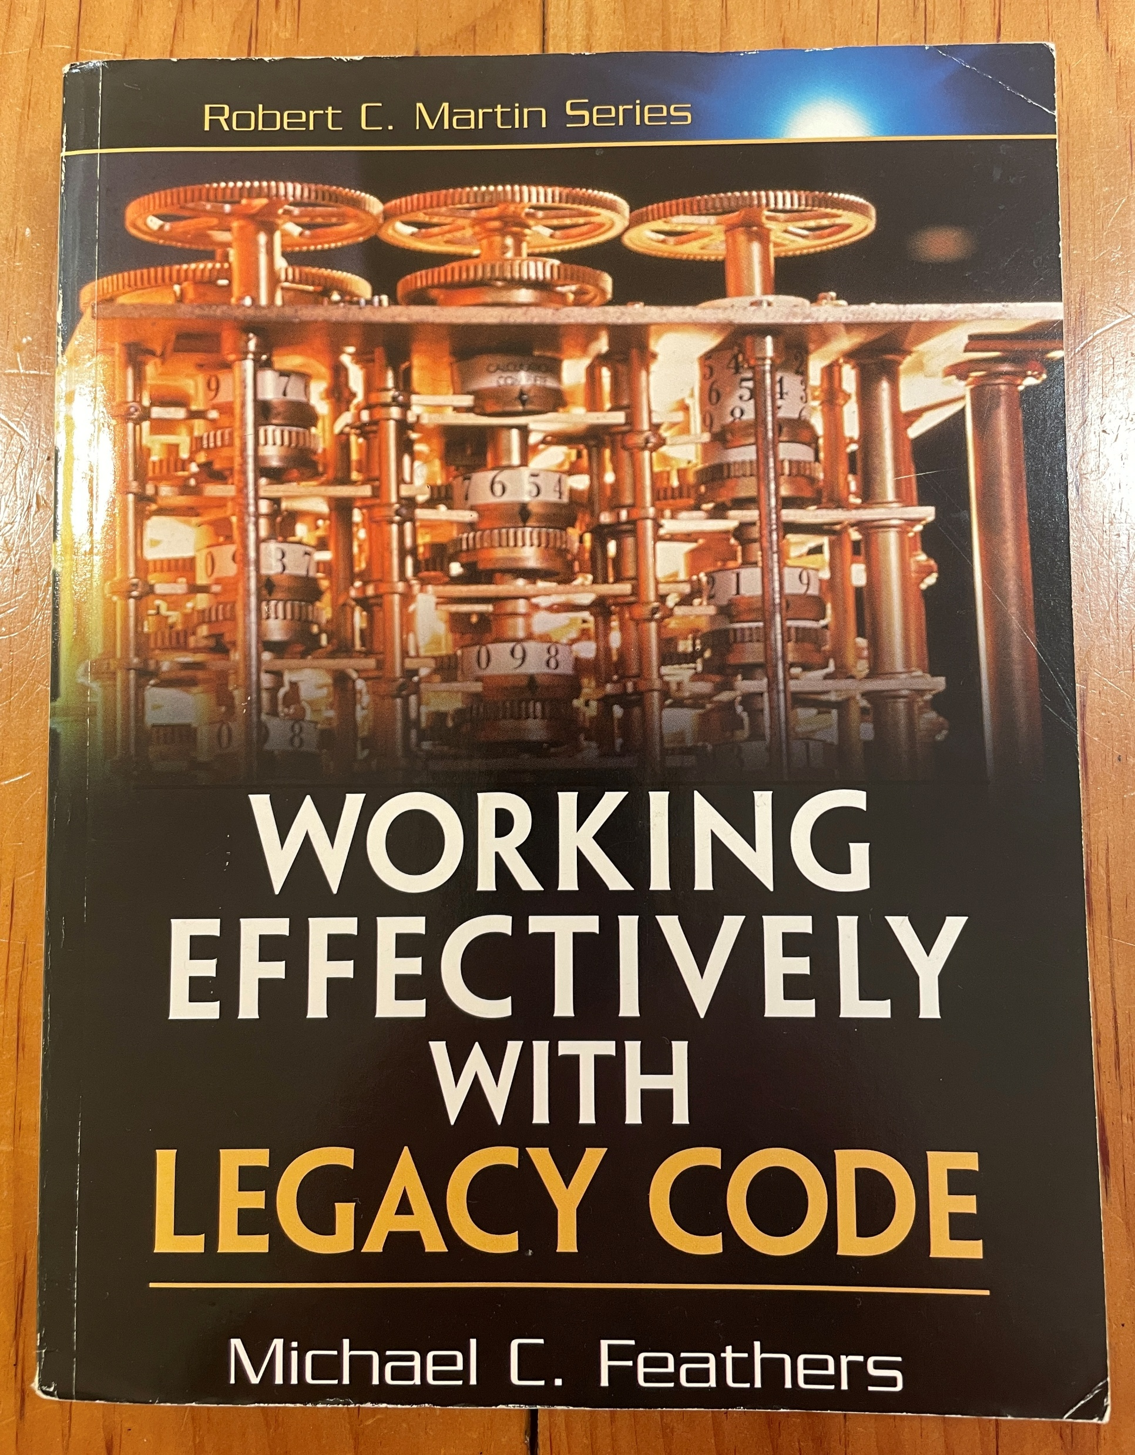
Characterisation Tests

Slide 15
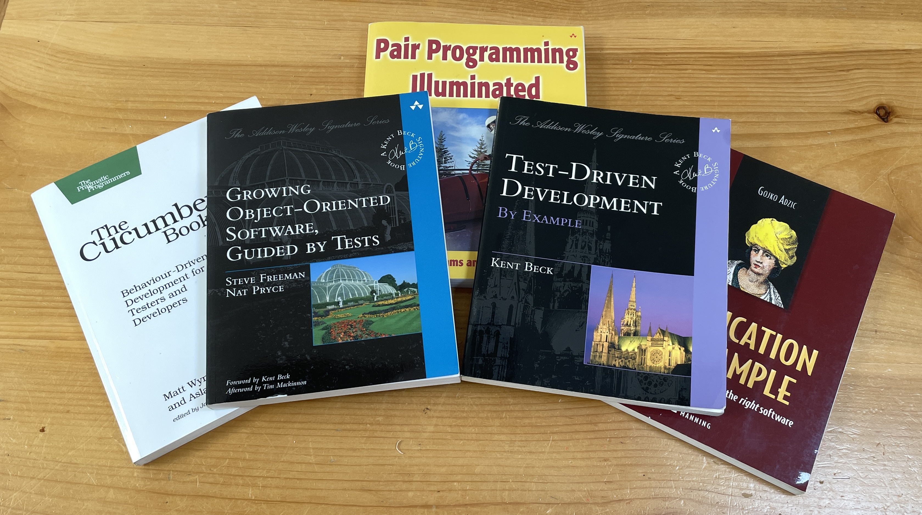
The Inner Loop

Slide 16
Pyramids & Polygons
Customer Tests
Programmer Tests

Slide 17
The Customer Demo
“Users don't know what they want until they see working software”
-- Humphrey’s Law (as per Jeff Sutherland)

Slide 18
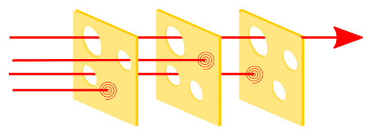
One Size Never Fits All
https://en.wikipedia.org/wiki/Swiss_cheese_model

Slide 19
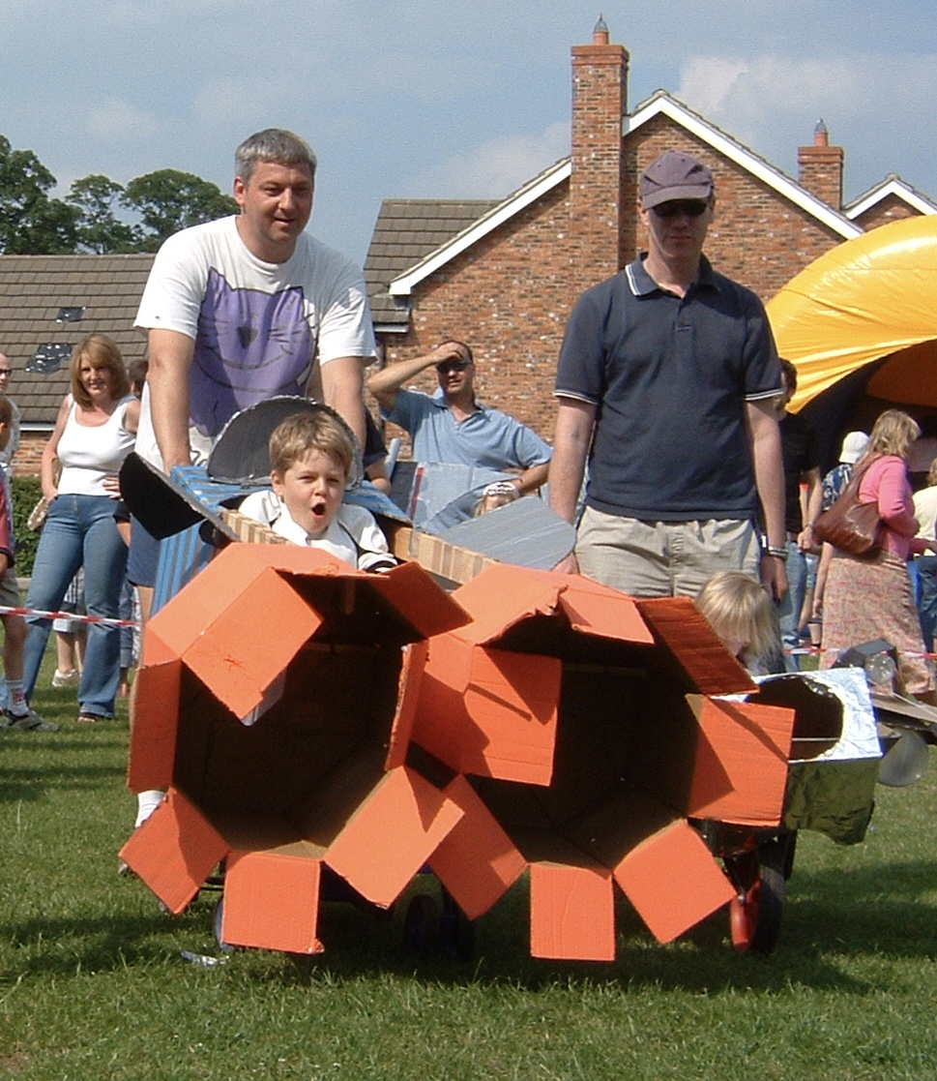
Test Validate in Production

Slide 20
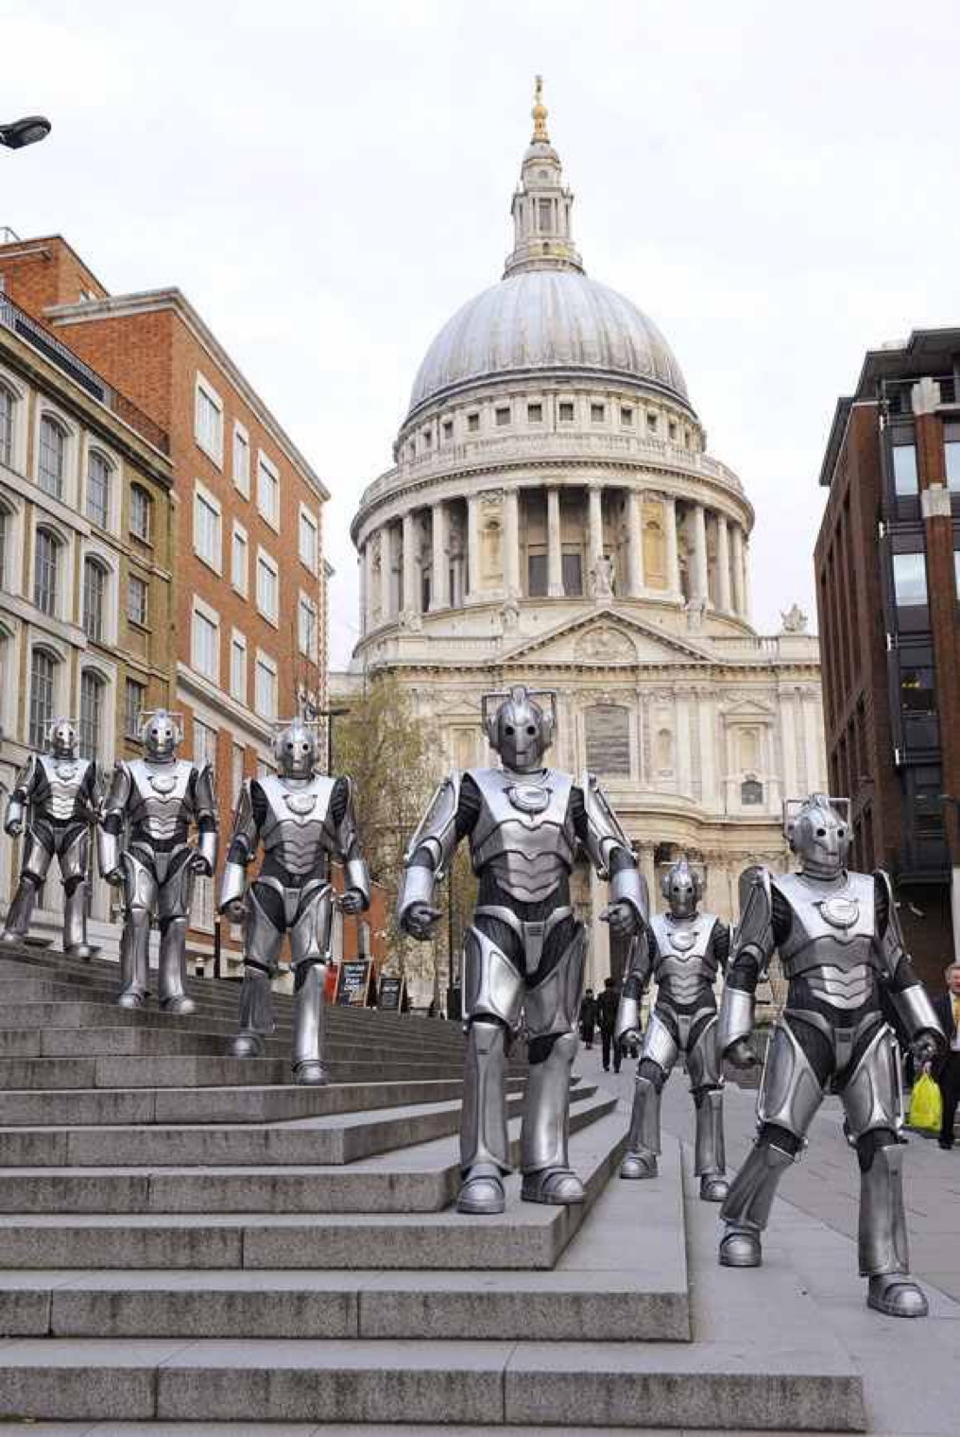
AI Friendly

Slide 21
Dijkstra
“Program testing can be used to show the presence of bugs, but never to show their absence”

Slide 22
Assert.That(Finished, Is.True);
Blog:
http://chrisoldwood.blogspot.co.uk
Articles:
http://chrisoldwood.com/articles.htm
Talks:
http://chrisoldwood.com/articles.htm

